Slide 1
Travel Insurance Customers Travel Habits
Travel Assured
Thomas Fishwick
Notes:
Here we are looking at the travel habits of customers and non-customers to see who we should advertise to

Slide 2
Average Customer/Non-Customer
29.9 years old
$1,133,239 average annual income
4.9 family members
Works in the Private Sector
No chronic disease
Hasn’t travelled abroad
Not a frequent flyer (but those who are frequent flyers are more likely to get insurance)
Graduate
29.5 years old
$821,300 average annual income
4.7 family members
Works in Private Sector
No chronic disease
Hasn’t travelled abroad
Not a frequent flyer
Graduate
Notes:
Here is the summary of customers and non-customers. We can see that the main differences are that customers are slightly older, earn much more than non-customers and have slightly more family members

Slide 3
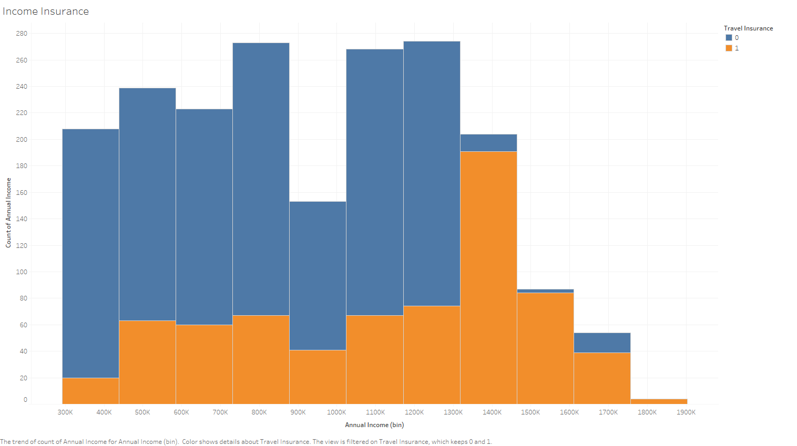
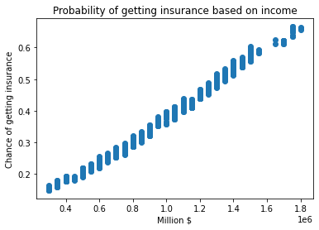
Effect of annual income on sales
Notes:
You can see that as an individual’s annual income increases they are more likely to buy insurance and its effect can be shown in a simple predictive model. We cannot prove cause and effect with statistics, but after customers get into the income bracket of 1.4 million dollars they are almost certain to get travel insurance and not too likely to get insurance otherwise

Slide 4
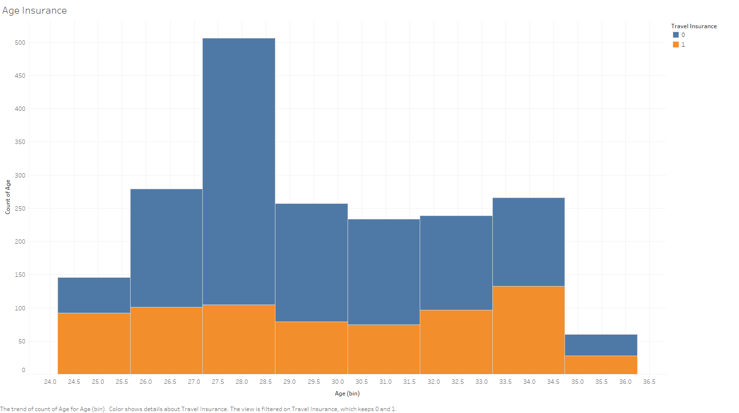
Differences between customers and non-customers
Notes:
It appears that 28 year olds are a key sector, but most choose to travel without insurance. Generally for the other age groups around half take insurance and half do not.

Slide 5
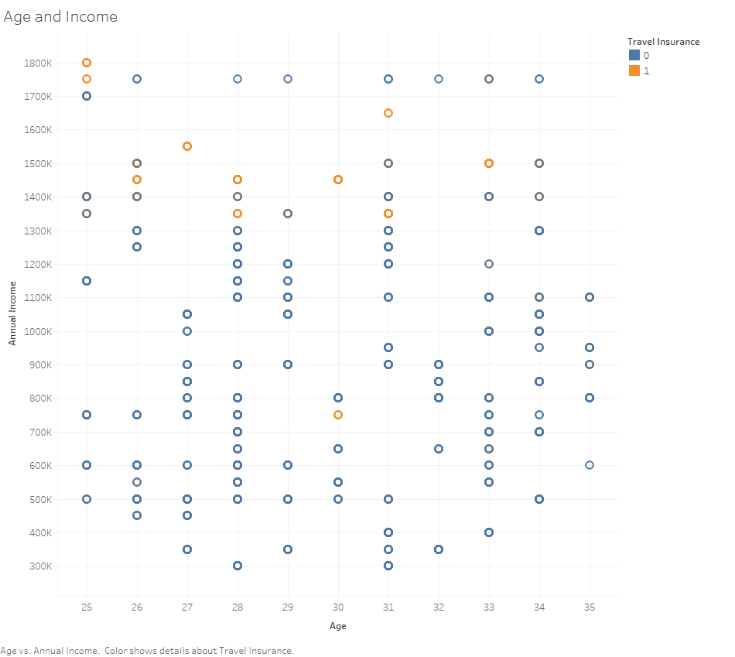
Age and Income effect on insurance
Notes:
We can see that incomes effect on whether a customer buys travel insurance is much more pronounced when both are shown together

Slide 6
Habits
Those customers who book tickets frequently (frequent flyers) are much more likely to get insurance (57% of frequent flyers versus 30% of non-frequent fliers)
Government Sector workers are much less likely to buy insurance than Private Sector/Self-Employed workers (25% of Public sector versus 40% of Private Sector/Self-Employed)
Those who had travelled abroad before are much more likely to buy insurance (78% travelled aboard before got insurance, versus 26% of those who had never travelled abroad getting insurance)
Notes:
You would be correct in thinking that frequent flyers are more likely to get insurance, 57% of them purchase travel insurance, while only 30% of non-frequent flyers purchase insurance.
Where you work has an effect, as only 25% of public sector workers buy insurance while 40% of private Sector workers buy insurance.
78% of those who had previously travelled abroad bought insurance versus 26% of those who had never travelled abroad

Slide 7
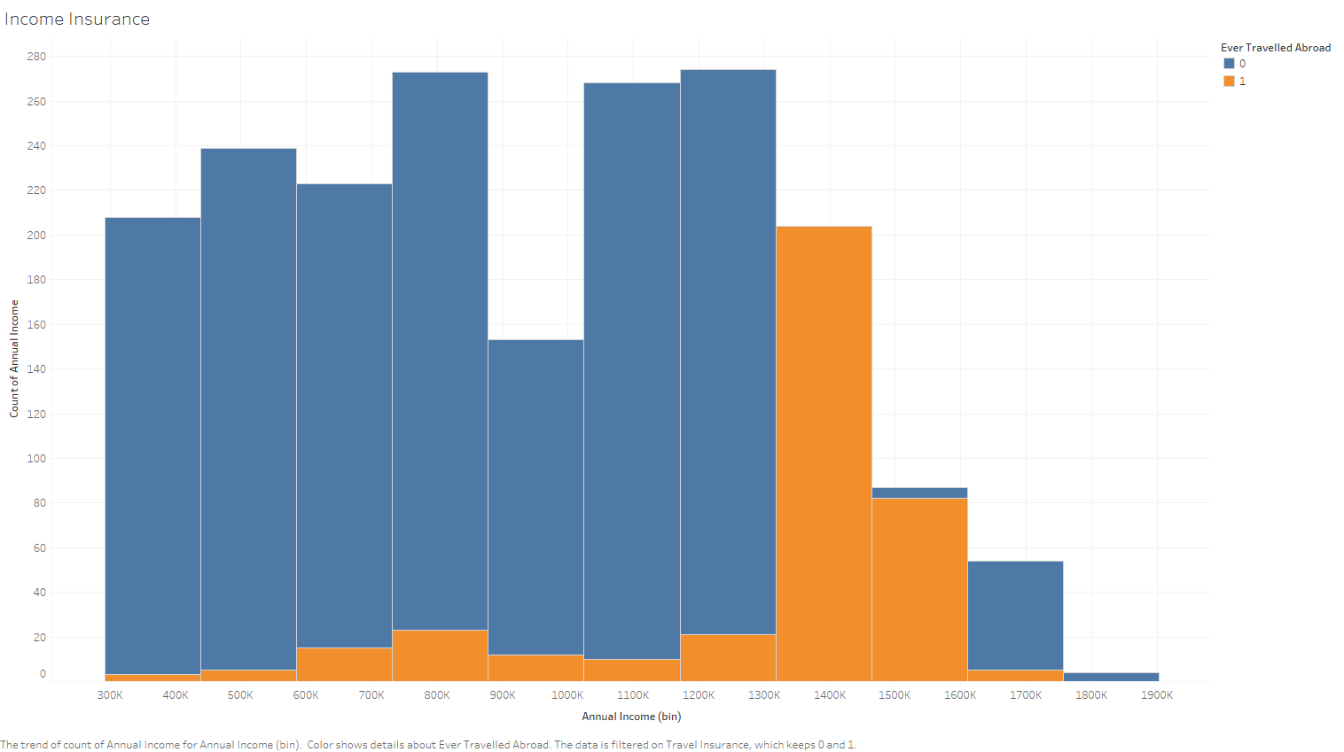
Potential Actions
To break into the lower income/never travelled abroad band, you could introduce a lower price for these customers or a special offer to tempt them in
Notes:
To try to get more people from lower income brackets you could try introducing a lower price or a special offer for them. Or attempt scary advertising

Slide 8
Who to advertise to
Lower income groups ($300k-$1.3m)
Those aged 27-29
People with 5 family members
Public sector workers
People who have never travelled abroad
Those who are not frequent flyers
Notes:
The broadest group to try to advertise to would be people in the lower income groups. To narrow it down you could also filter to those between 27 & 29. Further to those with five family members and then to public sector workers. Though if you go too far down the list you will no longer be advertising to anyone.
Thank you for your time and I look forward to hearing from you if you have any questions or require further information

